Slide 1
Federated Mission Networking – What are the benefits?
Kommunikáció 2019 konferencia
2019. November 14
LTC Laszlo DOZSA
Hungarian defence Forces

Slide 2
Agenda
Aim
Global security environment
Interoperability
Road to FMN
Federated Mission Networking Basics
Benefits
Required contribution

Slide 3
Aim
To inform the participants on the potential benefits of Federated Mission Networking and how to contribute to the common effort.
Notes:
To inform the participants on the potential benefits of Federated Mission Networking.
I do not undertake to educate participants on FMN, instead I seek to elaborate on why and how FMN can be beneficial to those who participate in this NATO Initiative.

Slide 4
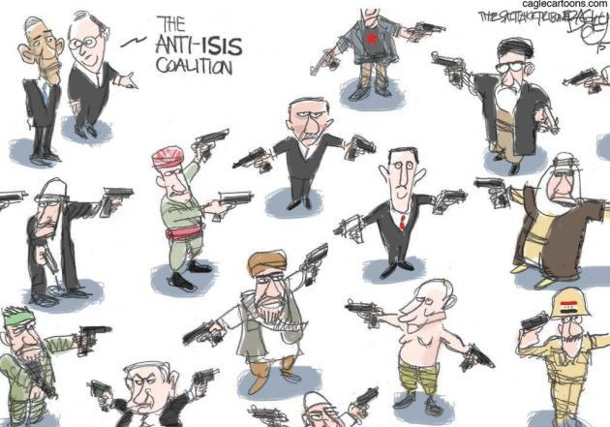
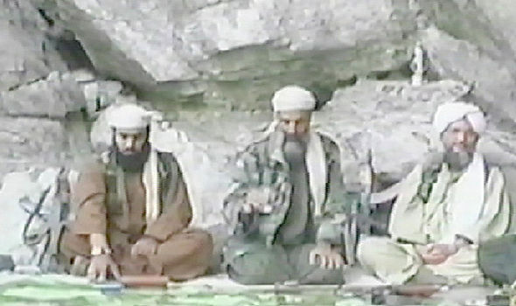
Global security environment
Global challenges, threats
Political, strategical implications
How to address the challenges?
Alone or in a coalition?
Enterprise or federated approach
Notes:
In today’s interconnected and globalised world, the number of challenges to our security is increasing. The complexity of the challenges requires complex answers. These challenges include the among others the following: global terrorism, global warming/climate change, mass migration. A single nation/organisation might find these challenges difficult to tackle on its own. Global challenges require coordinated and synchronised solutions. Nowadays nations and organisations rather work in a coalition than on their own. The reasons for involving multiple nations or organisations might be political, strategical or financial. If a nation/organisation decides to start a mission on its own, it will use its integral forces, processes and equipment. It can be very effective and efficient as the forces are equipped with interoperable equipment, use similar processes and are educated and trained. Note that for some larger nations/organisations, the technical interoperability among services (Navy, Army, Air Force…) might be quite demanding. However, if nations/organisations decide to react to a challenge jointly, it is imperative that their forces use interoperable equipment and are educated and trained to the same processes as much as possible.

Slide 5
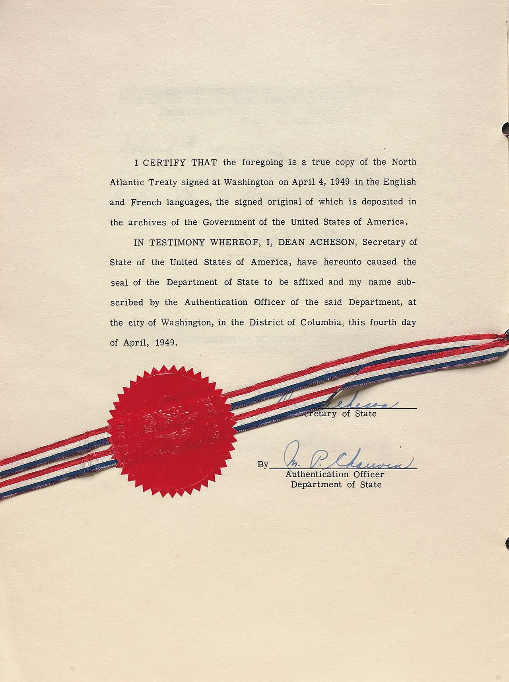
Interoperability
Oxford Dictionary
AAP-06 definition
The ability to act together coherently, effectively and efficiently to achieve Allied tactical, operational and strategic objectives.
AJP6 definition
Importance
North Atlantic Treaty – Article III:
The Parties … will maintain and develop their individual and collective capacity to resist armed attack.
Notes:
What is interoperability?
Oxford Dictionary
the ability of computer systems or programs to exchange information
the ability of military equipment or groups to work together
NATO GLOSSARY OF TERMS AND DEFINITIONS (ENGLISH AND FRENCH) 2017 – AAP-06 definition:
The ability to act together coherently, effectively and efficiently to achieve Allied tactical, operational and strategic objectives.
ALLIED JOINT DOCTRINE FOR COMMUNICATION AND INFORMATION SYSTEMS – AJP6 definition:
Importance of interoperability:
1. It is fundamental in order to achieve the common goals in a coalition. Without interoperability
Article 3 of the North Atlantic Treaty:
In order more effectively to achieve the objectives of this Treaty, the Parties, separately and jointly, by means of continuous and effective self-help and mutual aid, will maintain and develop their individual and collective capacity to resist armed attack
https://www.nato.int/cps/en/natolive/topics_84112.htm
An Alliance of 29 nations can only work effectively together in joint operations if provisions are in place to ensure smooth cooperation. NATO has been striving for the ability of NATO forces to work together since the Alliance was founded in 1949. Interoperability has become even more important since the Alliance began mounting out-of-area operations in the early 1990s.

Slide 6
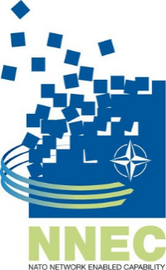
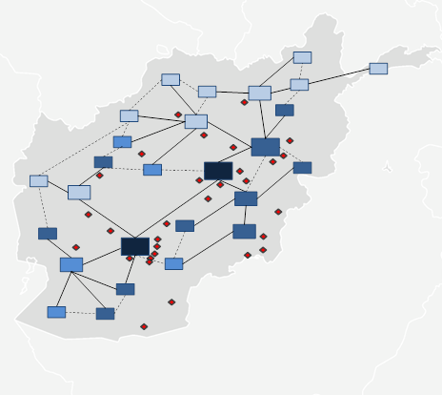
Road to FMN
Cold War approach
NNEC
ISAF and Afghan Mission Network
Future Mission Network
Federated Mission Networking
Afghanistan Mission Network
Notes:
At the Prague Summit in November 2002, NATO recognized that transformation of the military based upon Information Age principles was essential, and pursued a course of transformation denoted as NATO Network-Enabled Capabilities (NNEC).
In November 2003, nine NATO nations (Canada, France, Germany, Italy, The Netherlands, Norway, Spain, The United Kingdom and The United States) signed an arrangement to join in funding a feasibility study on NATO Network Enabled Capability (NNEC) as an important step towards NATO transformation. The study was carried out by the NATO C3 Agency (NC3A).
In 2009, the ACT launched an awareness campaign within NATO, as well as in NATO Nations and beyond, to promote the NNEC concept and have it adopted NATO-wide. Achieving full collaboration and full coherence between the various NATO and NATO Nations projects is the long term goal.
NNEC is about people first, then processes, and finally technology.
The Afghanistan Mission Network (AMN) is the primary Coalition, Command, Control, Communications, Computers, Intelligence, Surveillance, and Reconnaissance (C5ISR) network for NATO-led missions in Afghanistan (ISAF, RSM). By providing a common network over which to share critical information, the AMN enabled a shift in information-sharing posture from "need to know" to "need to share," resulting in an increase in situational awareness among coalition partners.[1][2] AMN establishes a common information sharing platform that provides standardised services such as email, instant messaging or chat, Common Operational Picture service, VTC, Voice over IP and Web Services for document sharing and application integration to all coalition participants. The effort generated invaluable lessons in how to approach coalition networking in future operations. Based on those lessons learned with AMN, NATO is institutionalising this approach under the Federated Mission Networking initiative.

Slide 7
Federated Mission Networking
Vision
Day Zero Interoperable Forces
Mission
Enhanced Operational Readiness & Effectiveness Today and in the Future
Key principles
Notes:
Key principles:
Supports an Uncertain Future
Maximum Reuse and Cost Effectiveness
Provide graduated options for participation
Information Centric
Supports Dynamic Federation
Synchronize capability evolution of participants
Enables organizations to act as a mission partner for nations

Slide 8
Federated Mission Networking – Key components
FMN Governance
Lead
MISSION Y
Lead
EXERCISE X
selected & tailored to
the mission
selected & tailored to
the mission
Standards
Baselines
Capability Roles
MISSION NETWORKS
Procedures
Services
Processes
MANAGEMENT
MANAGEMENT
Instructions & Templates
Reference & Target Architectures
FRAMEWORK PROCESSES
FMN FRAMEWORK
Notes:
Supports an Uncertain Future
Maximum Reuse and Cost Effectiveness
Provide graduated options for participation
Information Centric
Supports Dynamic Federation
Synchronize capability evolution of participants
Enables organizations to act as a mission partner for nations

Slide 9
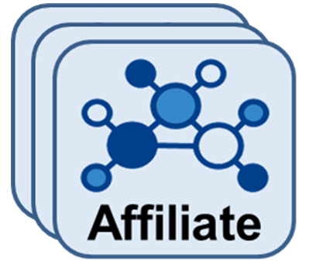
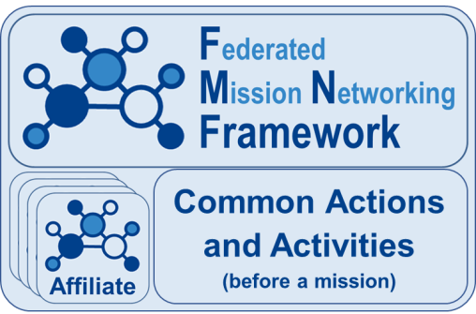
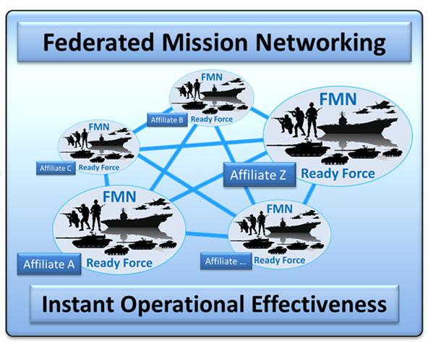
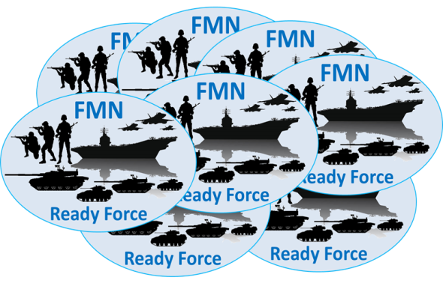
FMN – Affiliates’ role in creating FMN-Ready Forces
Enables
to create
for

Slide 10
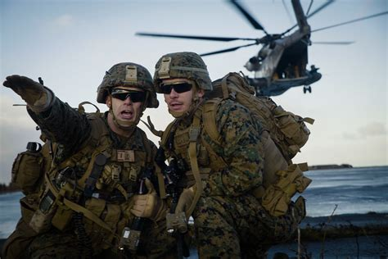
Benefits
‘Day Zero’ interoperability via FMN-Ready forces;
Equipped with technically verified equipment;
FMN Baseline contains verified and validated services;
Trained and exercised to become ready.
Enhanced operational readiness;
Effective and efficient command and control of forces;
Saving lives
Avoiding fratricide;
Minimising collateral damage by providing proper information in a timely manner.
Notes:
Subjective - it might be different for every Affiliate

Slide 11
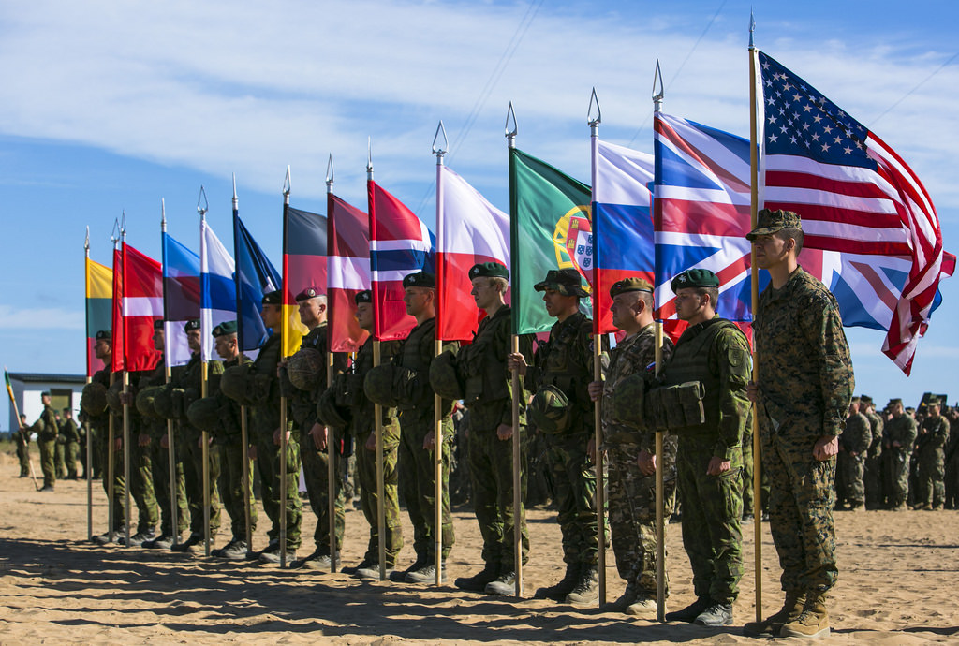
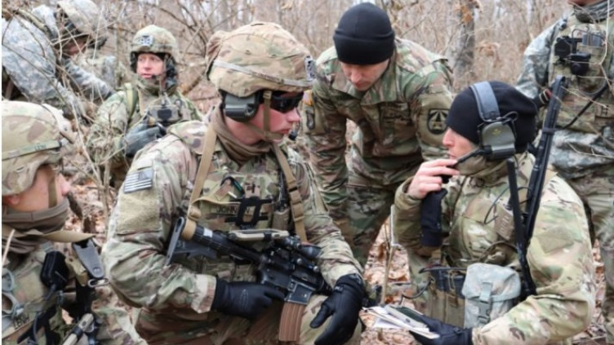
Benefits
More effective capability building
Static and Deployable domain.
Improved and smoother information share;
Need to know vs. need to share
Rapid Mission Network instantiation;
Building trust among Affiliates;
Saving resources;
Involving Partner nations.
Notes:
Building trust among Affiliates:
Developing agreed capabilities;

Slide 12
Required contribution
FMN relies on Affiliates’ contribution;
How to contribute?
Participation in the FMN WGs/TFs meetings;
Contributing during and between meetings to the products/efforts of the WGs/TFs;
Development of capabilities according to the approved Spirals;
Education and training of personnel;
Providing observations from Mission Network Instantiations to the FMN Framework;
Sharing best practices among Affiliates.

Slide 13
Summary
Global security environment
Interoperability
Road to FMN
Federated Mission Networking Basics
Benefits
Required contribution

Slide 14
References
FMN Implementation Plan
FMN Vision
NATO Portal (www.nato.int)
APP-6
AJP-6
FMN Portal (https://dnbl.ncia.nato.int)

Slide 15
Q&A
Questions?

